Slide 1
Objectives
In this session, you will learn to:
  Identify tips of logical database design

Slide 2

Tips on Logical Database Design
Here are some tips and
guidelines on database design.
Notes:
Student already have learnt about type 2 SCDs in Module I. Therefore, you can start this topic by asking the following questions to students:
What are type 2 SCDs?
Given an example to explain type 2 SCDs.
This will recapitulate what they have learnt about type 2 SCD in Module 1.
Now explain the strategy to update the data into these dimension tables with help the example given in SG.
After explaining the examples, you can ask students to think of an example of a type 2 SCD and then tell the strategy to update the data into this dimension table.

Slide 3
Attributes
Do not introduce any unnecessary attributes.
An attribute serves the following purposes:
  It identifies its owner entity.
  It refers to another entity.
  It simplifies the description of an entity.
  If there are any entities with common attributes, merge the entities.
Notes:
Student already have learnt about type 2 SCDs in Module I. Therefore, you can start this topic by asking the following questions to students:
What are type 2 SCDs?
Given an example to explain type 2 SCDs.
This will recapitulate what they have learnt about type 2 SCD in Module 1.
Now explain the strategy to update the data into these dimension tables with help the example given in SG.
After explaining the examples, you can ask students to think of an example of a type 2 SCD and then tell the strategy to update the data into this dimension table.

Slide 4
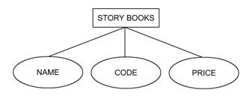
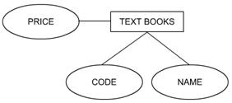
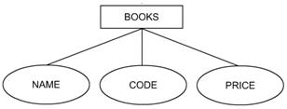
Attributes (Contd.)
The following diagram shows how you can merge two entities that contain common attributes.
Every category of book will have NAME, CODE, and PRICE as its attributes.
Instead of making STORY BOOKS and TEXT BOOKS as different entities, you can create one entity, BOOKS.
Notes:
Student already have learnt about type 2 SCDs in Module I. Therefore, you can start this topic by asking the following questions to students:
What are type 2 SCDs?
Given an example to explain type 2 SCDs.
This will recapitulate what they have learnt about type 2 SCD in Module 1.
Now explain the strategy to update the data into these dimension tables with help the example given in SG.
After explaining the examples, you can ask students to think of an example of a type 2 SCD and then tell the strategy to update the data into this dimension table.

Slide 5
Keys
An RDBMS identifies and locates rows by value.
The physical address is transparent to the user.
Relational systems require keys that can uniquely identify the rows of a table.
The various types of keys used in an RDBMS are:
  Primary
  Foreign
  Candidate
  Alternate
  Composite
Notes:
Student already have learnt about type 2 SCDs in Module I. Therefore, you can start this topic by asking the following questions to students:
What are type 2 SCDs?
Given an example to explain type 2 SCDs.
This will recapitulate what they have learnt about type 2 SCD in Module 1.
Now explain the strategy to update the data into these dimension tables with help the example given in SG.
After explaining the examples, you can ask students to think of an example of a type 2 SCD and then tell the strategy to update the data into this dimension table.

Slide 6
Keys (Contd.)
Any attribute (or set of attributes) that uniquely identifies a row in a table is a candidate for the primary key. Such an attribute is called a candidate key.
Any attribute that is a candidate for the primary key but is not the primary key is called the alternate key.
When the key that uniquely identifies the rows of the table is made up of more than one attribute, it is called a composite key.
Notes:
Student already have learnt about type 2 SCDs in Module I. Therefore, you can start this topic by asking the following questions to students:
What are type 2 SCDs?
Given an example to explain type 2 SCDs.
This will recapitulate what they have learnt about type 2 SCD in Module 1.
Now explain the strategy to update the data into these dimension tables with help the example given in SG.
After explaining the examples, you can ask students to think of an example of a type 2 SCD and then tell the strategy to update the data into this dimension table.

Slide 7
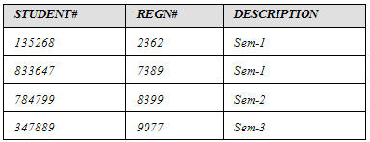
Keys (Contd.)
Consider the STUDENT table, as shown in the following diagram.
If STUDENT# is chosen as the primary key, then REGN# is the alternate key.
STUDENT# and REGN# are both individually unique in every row.
Candidate keys
Primary key
Alternate key
Notes:
Student already have learnt about type 2 SCDs in Module I. Therefore, you can start this topic by asking the following questions to students:
What are type 2 SCDs?
Given an example to explain type 2 SCDs.
This will recapitulate what they have learnt about type 2 SCD in Module 1.
Now explain the strategy to update the data into these dimension tables with help the example given in SG.
After explaining the examples, you can ask students to think of an example of a type 2 SCD and then tell the strategy to update the data into this dimension table.

Slide 8

Keys (Contd.)
Consider the table, WORKING HOURS of an employee, as shown in the following diagram.
Composite key
EMPLID | PROJECTID | HOURS
E309 | P675 | 18
E453 | P908 | 5
E334 | P876 | 20
Each row can be uniquely identified by a composite key composed of EMPLID and PROJECTID.
Notes:
Student already have learnt about type 2 SCDs in Module I. Therefore, you can start this topic by asking the following questions to students:
What are type 2 SCDs?
Given an example to explain type 2 SCDs.
This will recapitulate what they have learnt about type 2 SCD in Module 1.
Now explain the strategy to update the data into these dimension tables with help the example given in SG.
After explaining the examples, you can ask students to think of an example of a type 2 SCD and then tell the strategy to update the data into this dimension table.

Slide 9
Just a minute
Define the following terms:
  Candidate Key
  Alternate Key
Solution:
  Any attribute (or set of attributes) that uniquely identifies a row in a table is a candidate for the primary key. Such an attribute is called a candidate key.
  Any attribute that is a candidate for the primary key but is not the primary key is called the alternate key.
Notes:
Student already have learnt about type 2 SCDs in Module I. Therefore, you can start this topic by asking the following questions to students:
What are type 2 SCDs?
Given an example to explain type 2 SCDs.
This will recapitulate what they have learnt about type 2 SCD in Module 1.
Now explain the strategy to update the data into these dimension tables with help the example given in SG.
After explaining the examples, you can ask students to think of an example of a type 2 SCD and then tell the strategy to update the data into this dimension table.

Slide 10
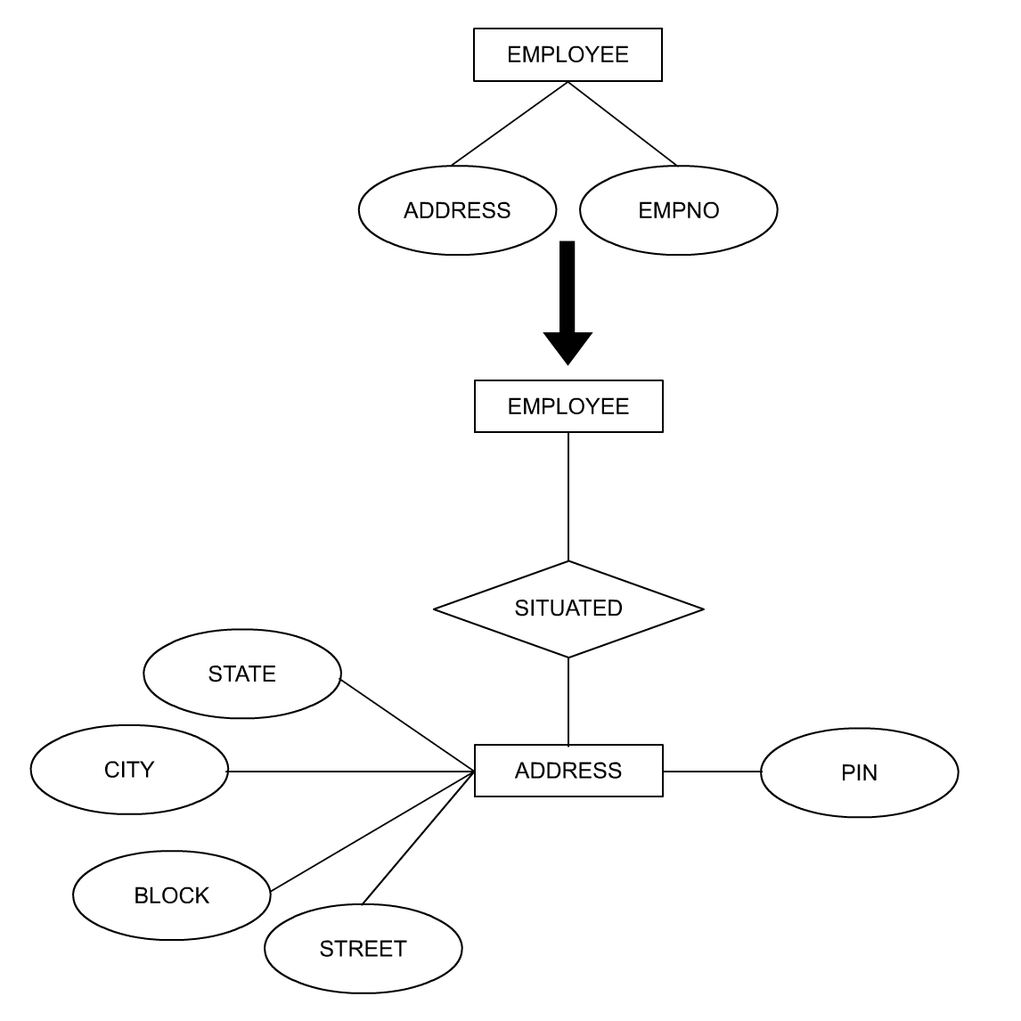
Entities
You can create a new entity to represent important recurring groups of attributes, as shown in the following diagram.
Attribute ADDRESS becomes an entity.
Notes:
Student already have learnt about type 2 SCDs in Module I. Therefore, you can start this topic by asking the following questions to students:
What are type 2 SCDs?
Given an example to explain type 2 SCDs.
This will recapitulate what they have learnt about type 2 SCD in Module 1.
Now explain the strategy to update the data into these dimension tables with help the example given in SG.
After explaining the examples, you can ask students to think of an example of a type 2 SCD and then tell the strategy to update the data into this dimension table.

Slide 11
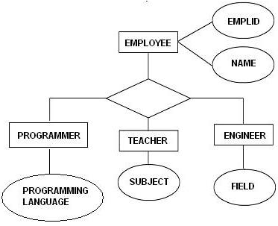
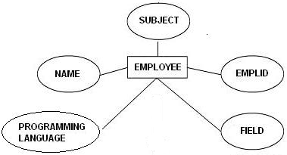
Subentities
Entities that have optional attributes can be replaced with subentities.
Specialization is the result of taking a subset of a
higher-level entity set to form a lower-level entity set, as shown in the following diagram.
EMPLOYEE is the
higher-level entity set, while PROGRAMMER, TEACHER, and ENGINEER are
lower-level entity sets.
Notes:
Student already have learnt about type 2 SCDs in Module I. Therefore, you can start this topic by asking the following questions to students:
What are type 2 SCDs?
Given an example to explain type 2 SCDs.
This will recapitulate what they have learnt about type 2 SCD in Module 1.
Now explain the strategy to update the data into these dimension tables with help the example given in SG.
After explaining the examples, you can ask students to think of an example of a type 2 SCD and then tell the strategy to update the data into this dimension table.

Slide 12
Subentities (Contd.)
Generalization is the result of taking the union of two or more lower-level entity sets to produce a higher-level entity set.
Generalization is the opposite of specialization.
In generalization, every higher-level entity must also be a lower-level entity. Specialization does not have this constraint.
Notes:
Student already have learnt about type 2 SCDs in Module I. Therefore, you can start this topic by asking the following questions to students:
What are type 2 SCDs?
Given an example to explain type 2 SCDs.
This will recapitulate what they have learnt about type 2 SCD in Module 1.
Now explain the strategy to update the data into these dimension tables with help the example given in SG.
After explaining the examples, you can ask students to think of an example of a type 2 SCD and then tell the strategy to update the data into this dimension table.

Slide 13
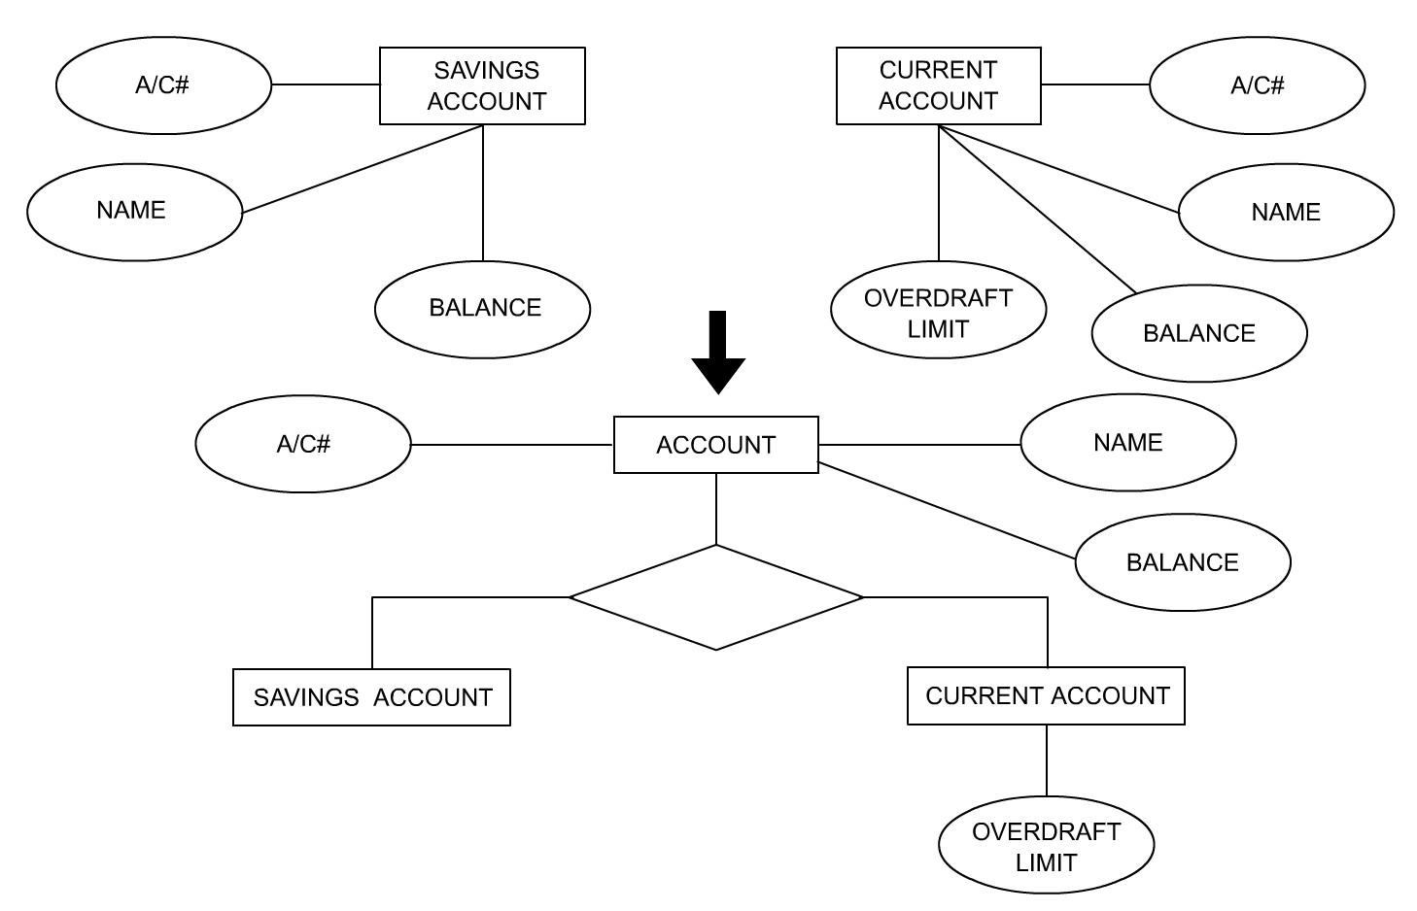
Subentities (Contd.)
The following diagram represents the concept of generalization.
Lower-level entity sets (SAVING ACCOUNT and CURRENT ACCOUNT) produce a
higher-level entity set (ACCOUNT).
Notes:
Student already have learnt about type 2 SCDs in Module I. Therefore, you can start this topic by asking the following questions to students:
What are type 2 SCDs?
Given an example to explain type 2 SCDs.
This will recapitulate what they have learnt about type 2 SCD in Module 1.
Now explain the strategy to update the data into these dimension tables with help the example given in SG.
After explaining the examples, you can ask students to think of an example of a type 2 SCD and then tell the strategy to update the data into this dimension table.

Slide 14
Summary
In this session, you learned that:
  A candidate key is a candidate for the primary key. An alternate key is a candidate key that is not a primary key.
  Optional attributes should be replaced with subentities. This is called specialization.
  To simplify multiple references, a new superentity should be introduced. This is called generalization.
Notes:
You can summarize the session by running through the summary given in SG.
In addition, you can also ask students summarize what they have learnt in this session.

